Slide 1
Data securing by using stenography
CAPSTONE PROJECT
Presented By:
Student Name : Devansh Gupta
College Name & Department : Government Holkar Science College, Department of Cyber Security

Slide 2
OUTLINE
Problem Statement
Technology used
Wow factor
End users
Result
Conclusion
Git-hub Link
Future scope

Slide 3
Problem Statement
The risk of unauthorized disclosure and leakage of data has increased with the increasing amount of personal information being carried over digital networks. Although traditional encryption techniques are useful in the majority of cases, they normally leak the encrypted information, which is vulnerable to attacks.
Although steganography, the technique of hiding data in other multimedia data, is an clandestine technique, it is faced with issues of resilience, capacity, and detectability.
This study seeks to investigate and develop steganographic methods of hiding sensitive information safely in digital media while maintaining data integrity and confidentiality without raising suspicion.

Slide 4
Technology used
In this model we use various technology and languages to utilise the data and hide the data in the given image.
In this we use languages :-
HTML
CSS
JAVASCRIPT
and we use STENOGRAPHY TECHNIQUE like Least Significant Bit (LSB) Method in this The secret message is converted into binary. Each bit of the message is embedded into the LSB of the red, green, and blue channels of the image's pixel data.
(By using this technique image quality doesn’t drop.)

Slide 5
Wow factors
It comes with simple and easy to use interface , with stemless web technology which help user to use it in any devices and Users don’t need to install any additional software—everything works in their browser, making it highly accessible.
Real-Time Encoding and Decoding
Users can encode a secret message into an image and decode it in real time.
The encoded image is displayed instantly, and the decoded message is revealed with a single click, creating a satisfying and interactive experience.
No Server-Side Processing
Everything happens client-side in the browser. This means:
No data is sent to a server, ensuring privacy and security. The application works offline once loaded, making it highly portable.

Slide 6
End users
End user are the those user who have a fear leaking personal data and data breach .
Users which upload data in cloud serves like google clouds, tera box, etc. this type user can use this to hide there data in the image so no one can access the data unless them, if there is any data leak happen in the cloud so there data is safe and secure in image and one can access it .
This is also used by the government bodies and officials to hide and secure there confidence data .

Slide 7
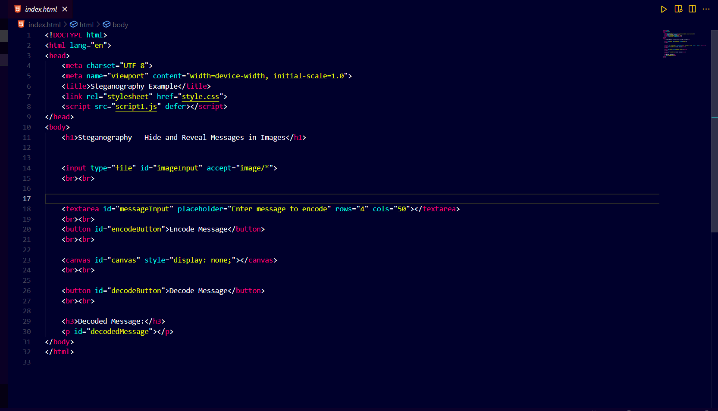
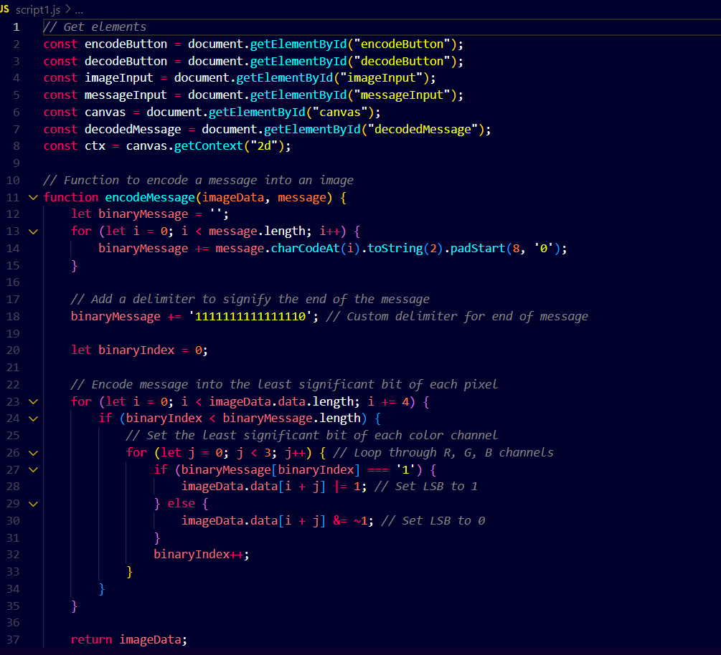
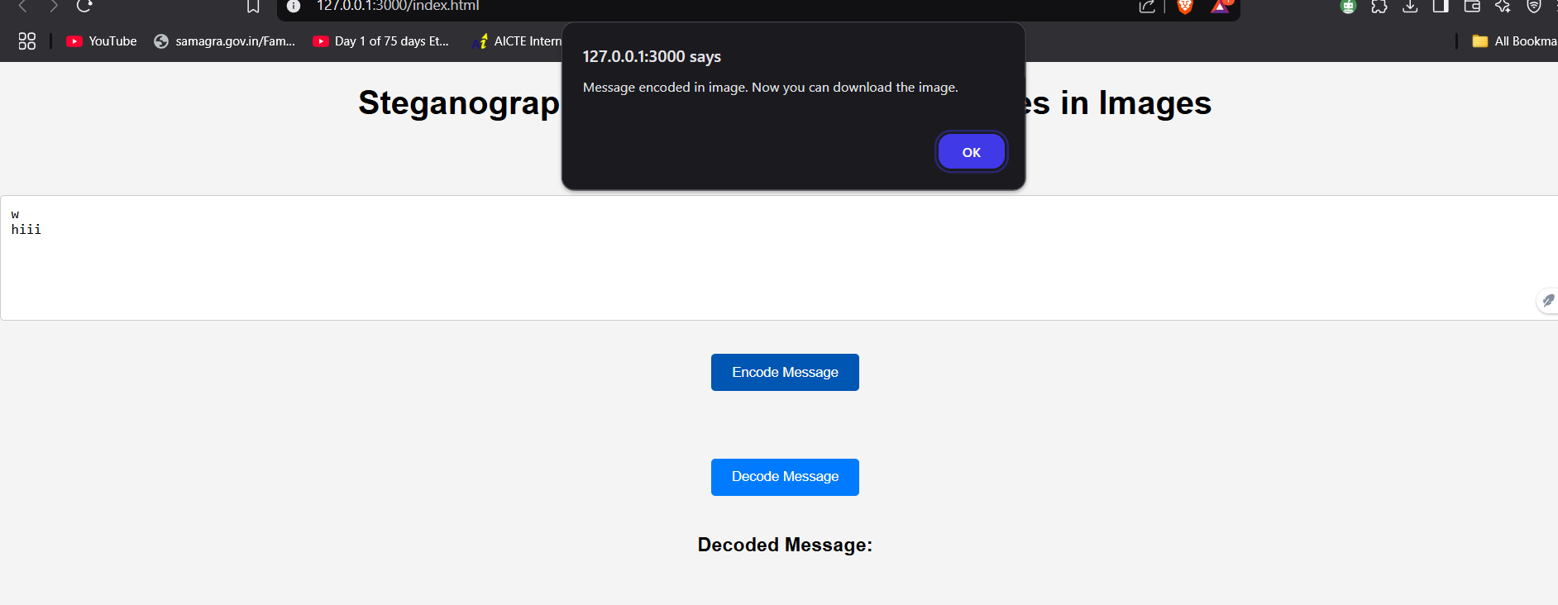
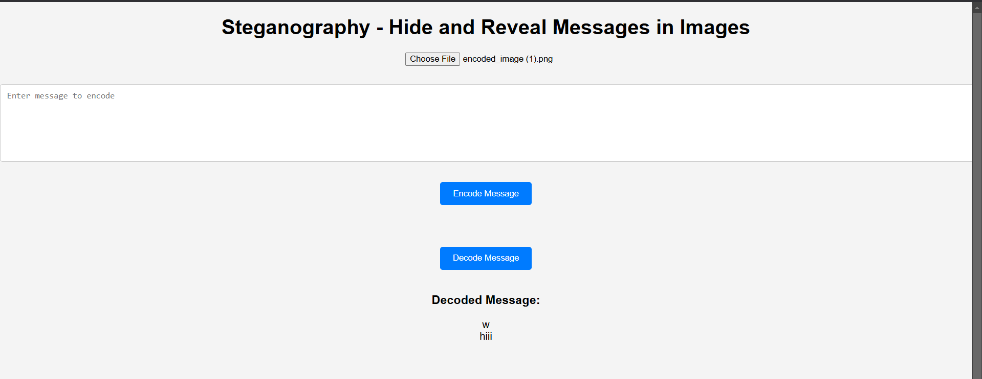
Results
Code:-
Encoding:-
Decoding:-

Slide 8
Conclusion
In this project I am using basic web development languages (like HTML, CSS, JavaScript) to make it simple and easy to understand by the user point of view. I use JavaScript for stenography and html and CSS for structure building.

Slide 9
GitHub Link
https://github.com/devataji/stenography-.git

Slide 10
THANK YOU

